Slide 1

CoderDojo
Scratch Beginners
Code and notes by permission Michael Madden, 2012

Slide 2
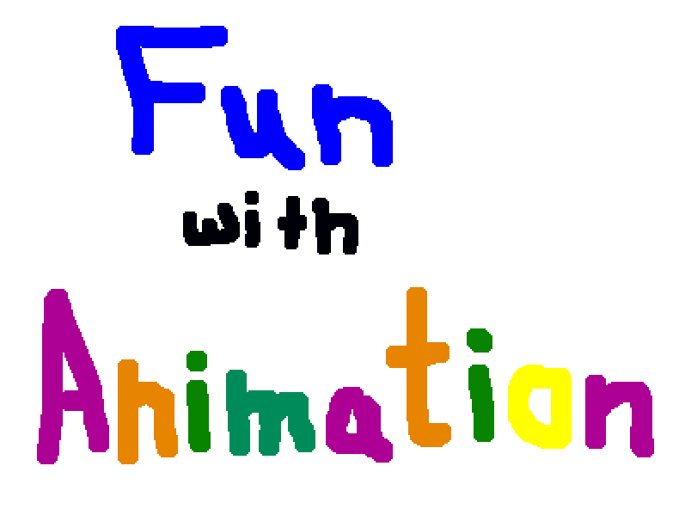
Today's Ninja Challenge: Create Games with Animation & Sound

Slide 3
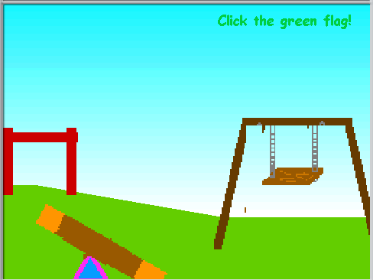
Today's Ninja Challenge: Create Games with Animation & Sound
Playground!
Notes:
Talk with Ninjas about what to do to create this application

Slide 4
Today's Big Ideas
Animation
Music
Loops

Slide 5
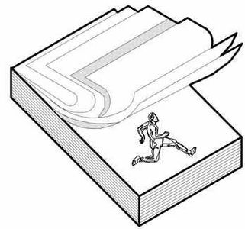
How Animation Works

Slide 6
Eadweard Muybridge “Father of the Motion Picture”
How Animation Works

Slide 7
Playground Demonstration

Slide 8
1. Background
First Project Today - Animation

Slide 9
2. Sprites with costumes
First Project Today - Animation

Slide 10
3. Loops
First Project Today - Animation

Slide 11
Playground: Add People and Animate Them
Notes:
Talk with Ninjas about what to do to create this application

Slide 12

Playground: Add People and Animate Them
People on the seesaw
Person on the swing
Different positions?
What about the monkey bar?
Copy costumes?

Slide 13
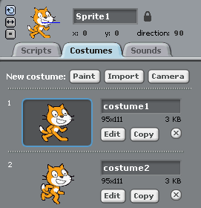


How Animation Works

Slide 14
Enhance your Animation with Music!

Slide 15
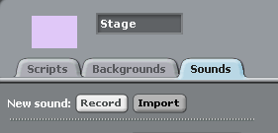
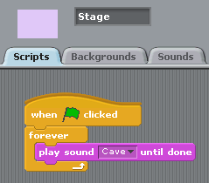
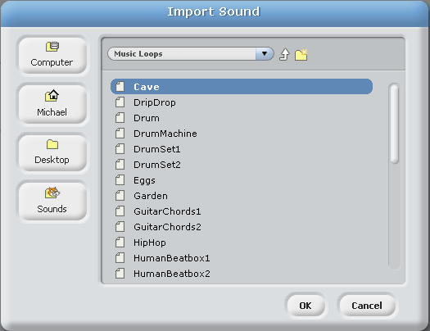
Music Backing Track

Slide 16
Telling Stories with Animation & Sound
?
Example: Star Wars movies!!

Slide 17
More Things to Try …
Change the appearance of your sprites the effects and colour features in the Looks tab!
Use motion features in the Motion tab to enhance your animation, like the Fun with Animation scratch application.

Slide 18
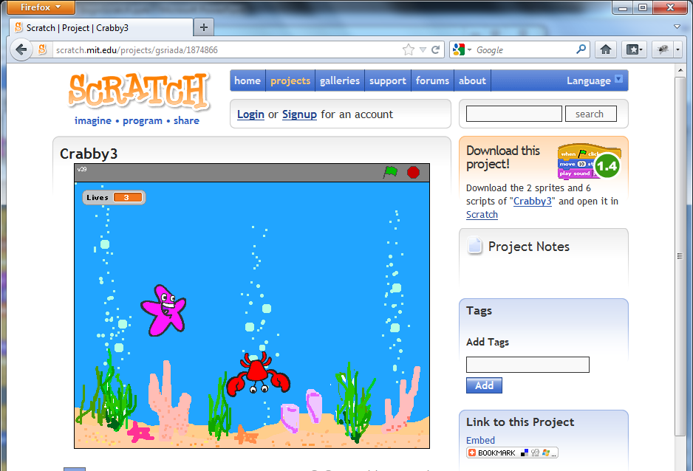
At the End …
Upload your project to the Scratch Website user: emcdojo password: cork123
Access it
from home
Improve it
Show your
friends!

